Slide 1




International Aid
Transparency Initiative (IATI)
Workshop – Tracking of Data of DRR and Recovery
Danila Boneva
IATI Secretariat, UNDP
14 April 2011, Helsinki

Slide 2

Why improve aid transparency?
Fundamental to all 5 Paris Declaration principles and for achieving the AAA transparency commitments of development assistance providers
Consistently identified as a top priority by partner countries for HLF4 – recent results of 2010 poll, strong partner country engagement in IATI
www.aidtransparency.net
Notes:
2
National ownership, alignment, harmonization, managing for development results and mutual accountability
HLF 4 2010 poll results: aid transparency is among the 4 top priorities following alignment, capacity development, managing for development results.

Slide 3
Why improve aid transparency in the context of DRR and Recovery (1)?
When a disaster strikes, response time and resources are scarce and should be invested in life-saving interventions.
Having the right systems in place to collect, share and account for aid and other flows will significantly improve information sharing and decision-making capacity of national authorities and development actors.
What is needed is up-to-date, timely, regular information, which is less and less dependent on manual entry and is provided in a standard and open format.
www.aidtransparency.net
Notes:
3

Slide 4
Why improve aid transparency in the context of DRR and Recovery (2)?
Transparency should be an integral part of the ‘business model’ of development actors:
  Invest in advance in information management systems, which can meet the IATI standard
  Put in place the necessary internal quality assurance mechanisms to allow the publication of information in as close to real time as possible
Promote an organizational culture, which espouses transparency and accountability
Publish information and work with other actors to ensure that there is transparency all along the delivery chain – transparency of donors and multilaterals is good, but it is not enough – NGOs, SSC providers, private sector, GoV need to join
www.aidtransparency.net
Notes:
4

Slide 5
How can IATI help? (1)
A global aid transparency standard across the spectrum of development actors
Publication of information at the agency and project level, ongoing and forward-looking data, results, documents & conditions – builds on the CRS
Timeliness: publish as soon as possible and at minimum quarterly
Comparability of data: key requirement for any meaningful decision-making process
Open format: XML - machine readable and can be used for crowd sourcing (e.g. Kenya, Haiti), mashing up of data, etc.
www.aidtransparency.net
Notes:
5

Slide 6
How can IATI help? (2)
Sectors: donors publish according to their own sectors and for those reporting to the CRS – also the CRS purpose codes – it may require for DRR and recovery-specific guidance similar to the gender and other policy markers to improve DRR tracking
Optional elements of the IATI standard such as geo-coding of project interventions will help with allocation decisions and better clarity on who does what where
Publication of results, especially if done in a machine-readable format (optional), will help improve aid monitoring & support impact assessments and beneficiary feedback
www.aidtransparency.net
Notes:
6
Geospacial data has been identified as a priority for improving the transparency and accountability of aid by the Int’l Organization of Supreme Audit Institutions (INTOSAI)

Slide 7
What IATI will not do?
Duplicate the work of the CRS – which is designed for a specific purpose
Create a parallel set of definitions and classifications - this work will only take place where no existing classifications exist
Design a new database – one database cannot meet all needs
Strengthen partner country transparency – this is important work, but is taking place elsewhere
www.aidtransparency.net
Notes:
7

Slide 8
The IATI Standard
A four-part standard for publishing aid information:
http://iatistandard.org/
Scope of what will be published
Common definitions for sharing information
Framework for implementation
Common electronic data format
www.aidtransparency.net
Notes:
8

Slide 9
Scope
Project level information
  Project details
  Financial information
  Indicators, Targets and Outcomes
  Project documentation
Forward planning budgets
  3-year forecasts
Non-aid flow related information
  Aid agreements, policies and procedures
  Country, regional & sectoral strategies
www.aidtransparency.net
Notes:
9

Slide 10
Definitions
Common definitions essential for data comparison
Code sets
  e.g. Sector Codes
Unique identifiers
  How to uniquely identify organisations and activities globally.
www.aidtransparency.net
Notes:
10

Slide 11
Framework for Implementation
Signatories agree to a set of commitments:
What to publish (2 phases and optional elements)
When to publish
  Regularity
  Timeliness
Public access
Licence to use and republish
Monitoring and evaluation mechanisms
www.aidtransparency.net
Notes:
11

Slide 12
Common Electronic Format
IATI xml schema
All donors to publish in IATI xml on own websites
IATI maintains central registry. Single point of discovery for users
Publish once – Use often
Automatic data exchange – incl. with partner country Aid Information Management Systems
www.aidtransparency.net
Notes:
12

Slide 13
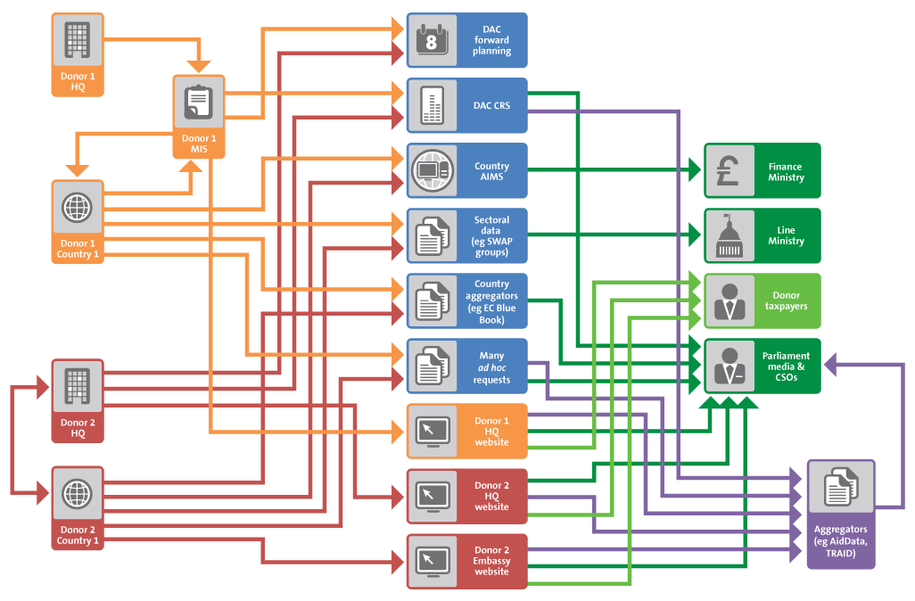
Publish often, use once
Notes:
13

Slide 14
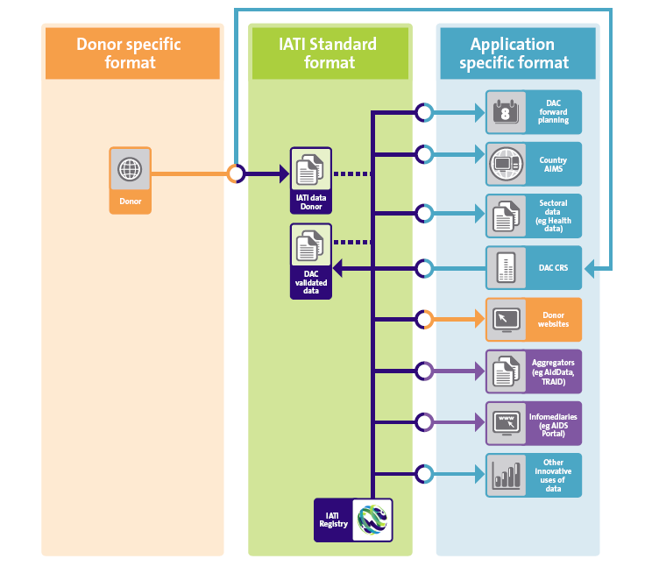
Publish once, use often
Notes:
14
The business case for IATI

Slide 15
Manual Data Exchange
Donor keys data into their own management system.
Donor prints report from their system.
Donor keys data into the government’s Aid Information Management System (AIMS) or Excel spreadsheet
or
Donor keys data into spreadsheet and sends to ministry. Ministry keys data into AIMS
www.aidtransparency.net
Notes:
15

Slide 16
Automatic Data Exchange
Donor keys data into their internal information management system
Donor publishes in IATI xml format on their own website.
Country system downloads and imports data.
Ministry and country donor staff access data in country system to check and modify.
www.aidtransparency.net
Notes:
16

Slide 17
5 Proof of Concept Country Pilots in 2010
Colombia (home-grown system), Burkina Faso, Malawi & DR Congo (Aid Management Platform) and Rwanda (Development Assistance Database)
Test automatic data exchange.
  Prepare donor data in draft IATI format
  Import IATI data into AMP & DAD (test system)
Analyse data issues:
  Does exchange satisfy country system needs
  Differences between Donor HQ and country systems
  Differences between published and keyed data
www.aidtransparency.net
Notes:
17

Slide 18
Donor Information Management Systems
Most country offices connected to HQ in real time
Most country offices have control over data input
Data validation takes place at HQ and country-level, but corrections at country-level
Report outputs are designed by HQ
HQs and country offices have the same access to the same data
HQs choose to publish different reports from country offices
www.aidtransparency.net
Notes:
18

Slide 19
Partner Country Aid Information Management Systems
More than 60 countries use them (home-grown, AMP and DAD)
Established following the 2004 Indian Ocean tsunami and other recent disasters (e.g. 2005 Pakistan and 2010 Haiti earthquakes)
Rely on manual entry of data from local donor offices
Use dual sector coding – national recovery/development plan sectors, less so national budget sectors and CRS purpose codes
Capturing of NGO and private sector information is usually poor – often reflects GoV-NGO relations
Quality of data varies
But the need for comparable and management-type of information (not audited) is tremendous
www.aidtransparency.net
Notes:
19
Reporting of aid flows is already happening at the country level
Demonstrates information needs of recipient countries. GoV need management information for decision-making, not audited data.
Different level of sophistication of AIMS (results, budget alignment, tracking of PD indicators).
Quality of information varies depending on GoV-donor relations in the country, capacity of government and donors, etc.
IATI wants to alleviate the burden from the recipient countries

Slide 20
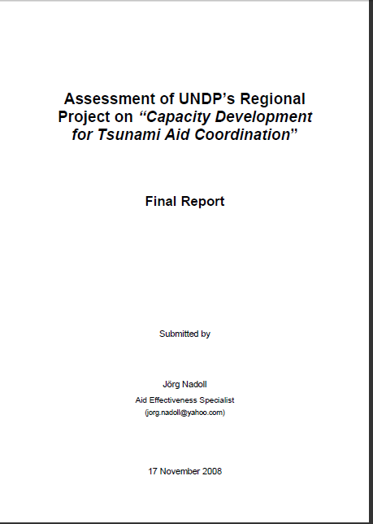
Lessons from post tsunami aid coordination (1)
Project teams had to spend considerable time and efforts on getting the databases to work properly, as well as on getting reliable data. As a result, the efforts
made to effectively use the systems to prepare well-packaged information products
that could inform dialogue and decision-making, as well as to enhance the capacities
of national governments to manage and maintain the systems independently, to use
them effectively and to coordinate foreign aid better were insufficient.
www.aidtransparency.net
Notes:
20
In the case of the tsunami, the systems were set up too late to inform decisions on aid allocation by donors. Indonesia was an exception since the system was used to facilitate a project approval process for all off-budget aid.
A database cannot ensure the accountability of GoV to citizens and of donors to GoV and citizens. MA framework is needed and such were not established in the aftermath of the disaster.
The changes and uncertainties deriving from the set-up of special reconstruction
agencies in Indonesia and Sri Lanka further complicated the institutionalization of the
Aid Information Management Systems (AIMS) in these countries.
Project teams at regional and country
level had to spend considerable time and efforts on getting the databases to work
properly, as well as on getting reliable data into the systems. As a result, the efforts
made to effectively use the systems to prepare well-packaged information products
that could inform dialogue and decision-making, as well as to enhance the capacities
of national governments to manage and maintain the systems independently, to use
them effectively and to coordinate foreign aid better were insufficient.

Slide 21
Lessons from post tsunami aid coordination (2)
An AIMS should ideally be established as part of regular investments in developing a permanent disaster response and aid management capacity.
Careful consideration for the creation of incentives for stakeholder participation, in particular data providers, should be given.
Keep the scope of the system manageable.
Strong government leadership is critical for set-up, use and sustainability of an AIMS.
AIMS need to be established as an integral part of the national aid coordination architecture and need an appropriate institutional home.
www.aidtransparency.net
Notes:
21
In the case of the tsunami, the systems were set up too late to inform decisions on aid allocation by donors. Indonesia was an exception since the system was used to facilitate a project approval process for all off-budget aid.
A database cannot ensure the accountability of GoV to citizens and of donors to GoV and citizens. MA framework is needed and such were not established in the aftermath of the disaster.
The changes and uncertainties deriving from the set-up of special reconstruction
agencies in Indonesia and Sri Lanka further complicated the institutionalization of the
Aid Information Management Systems (AIMS) in these countries.
Project teams at regional and country
level had to spend considerable time and efforts on getting the databases to work
properly, as well as on getting reliable data into the systems. As a result, the efforts
made to effectively use the systems to prepare well-packaged information products
that could inform dialogue and decision-making, as well as to enhance the capacities
of national governments to manage and maintain the systems independently, to use
them effectively and to coordinate foreign aid better were insufficient.

Slide 22
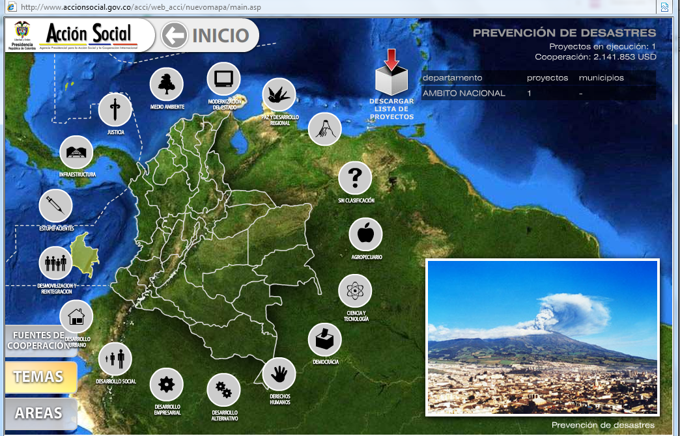
Home-grown system of Colombia
www.aidtransparency.net
Notes:
22

Slide 23
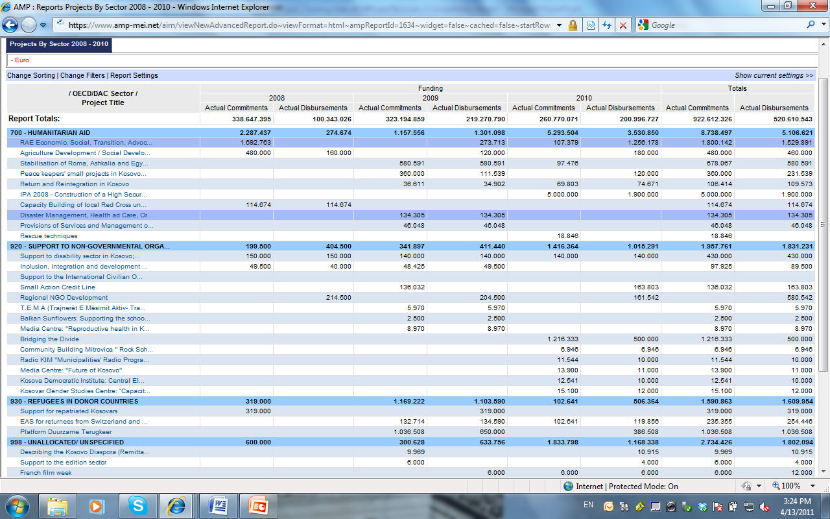
Aid Management Platform in Kosovo
www.aidtransparency.net
Notes:
23

Slide 24
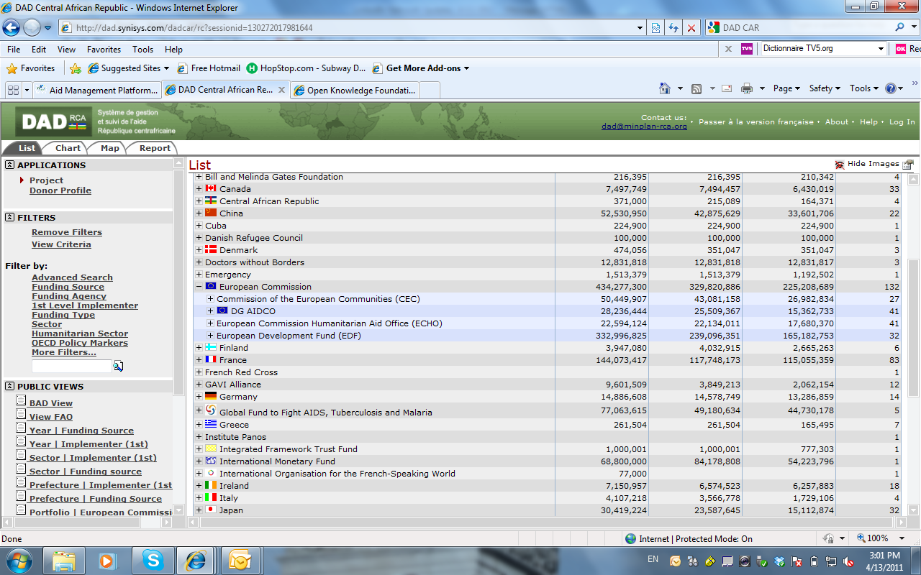
Development Assistance Database in CAR
www.aidtransparency.net
Notes:
24

Slide 25
The development actor dilemma
HQ | Country
Cautious | Pragmatic
Accuracy | Timeliness
Accountants/statisticians | Aid practitioners
Audited annual accounts | Monthly management accounts
www.aidtransparency.net
Notes:
25

Slide 26
Data collection/input
Government staff spend much time individually negotiating with each donor to provide data. In the critical period after a disaster has
Most donor country offices are keen to assist the AIMS but are restricted by resources and lack of suitable reports.
IATI will systematise this process.
A clear standard and Framework for Implementation for when and what donors will report.
www.aidtransparency.net
Notes:
26

Slide 27
Donor Publishing
Most donors currently only publish audited or validated data.
Audited data will always be published too late for planning purposes at the macro and sector level and to allow for information to be integrated in the different stages of the budget process.
Donors need to publish planning data – i.e. unaudited disbursements and forecasts.
If planning data is clearly labelled it cannot be misinterpreted.
Forecasts are not legal commitments, but donors should be accountable for the reasons why forecasts change.
www.aidtransparency.net
Notes:
27

Slide 28
IATI Process & Next Steps
IATI standard agreed in February 2011
Ongoing implementation of phase 1 of the standard: DFID, Hewlett Foundation and more donors will join prior to HLF4
Conduct partner country pilots to adjust and improve automated data exchange
Work with NGOs
Develop further the recipient budget identifyer
Report to the HLF IV in Seoul on progress made and build further momentum & political support
Agree post-2011 IATI governance and funding arrangements & institutional home
www.aidtransparency.net
Notes:
28

Slide 29
IATI Governance & Management
Secretariat: DFID, UNDP, Development Initiatives for Poverty Research (DIPR)
Funding: Netherlands, Ireland, Finland, Switzerland, UK, Australia, Spain.
Multi-stakeholder Steering Committee
Multi-stakeholder Technical Advisory Group (TAG)
Full IATI membership: 19 donor signatories and developing countries who have endorsed – 19 developing countries to date
New ‘IATI observer’ category
Partner country consultations led by UNDP
www.aidtransparency.net
Notes:
29

Slide 30
www.aidtransparency.net

